Slide 1

COMSATS UNIVERSITY ISLAMABAD, LAHORE CAMPUS
Recommendation System

Slide 2
CS-28
--
FYP-1
Supervisor: Ma’am Kanza Hamid
Group Leader: Ibad Ahmad – SP18-BCS-159
Recommendation System
Haseeb Yaseen – SP18-BCS-047
Wahaj Hafeez - SP18-BCS-007

Slide 3
CS-28
--
INTRODUCTION
RS background
Uses in Different Domains
Why Recommendation System?
Factors included in RS
Recommendation System

Slide 4
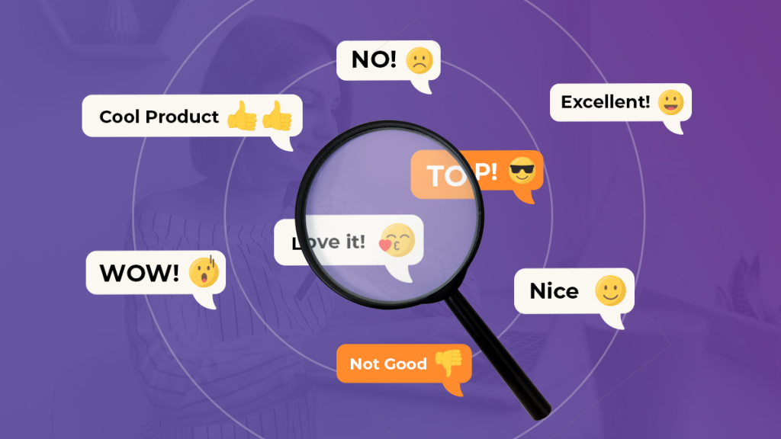
Problem Statements
Multiple Platforms for Multiple Businesses
Static System being used
Outdated user feedbacks
Balance between reviews and rating
Google Recommendations, Food Panda, Play Store etc.

Slide 5
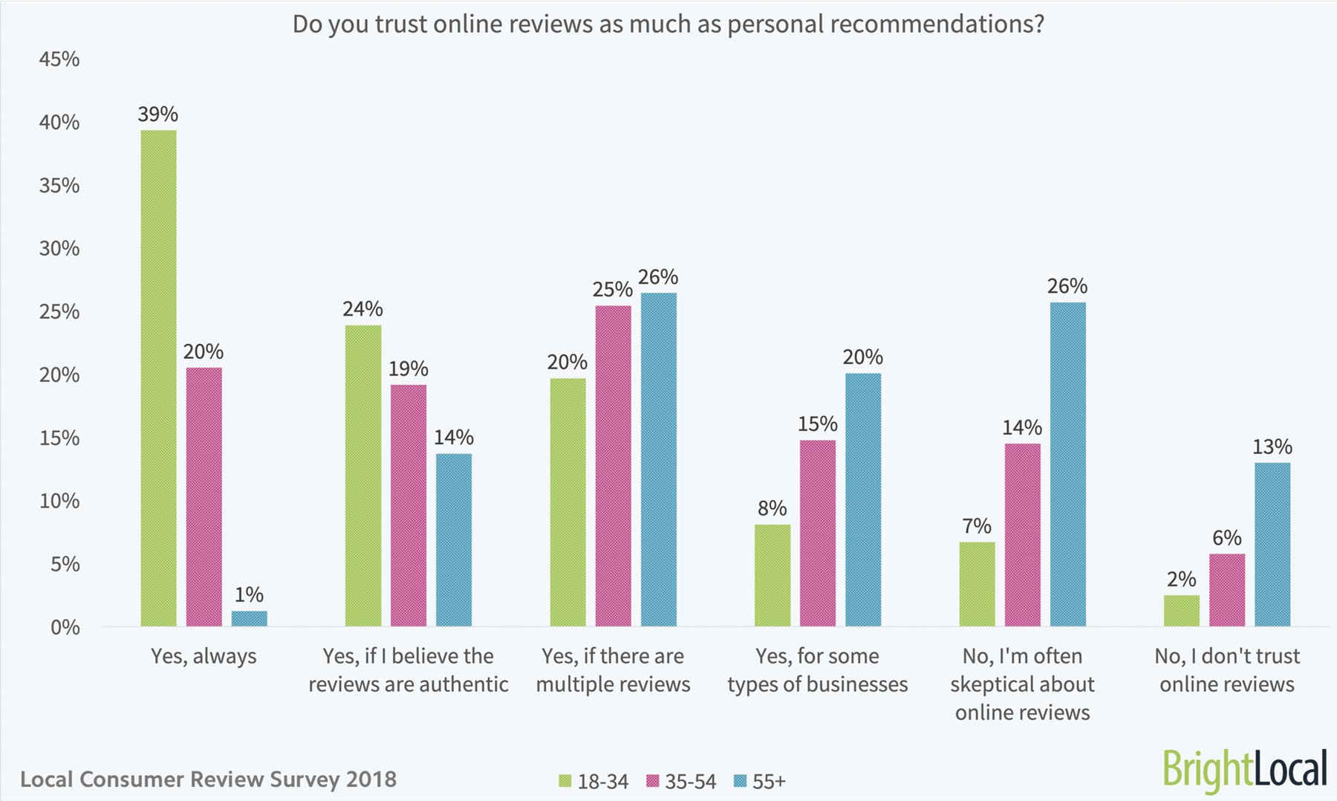
Importance of Online Reviews in Digital World
20
As of January 2018
Online Reviews Trust Ratio continues to rise in more countries and cities.
10

Slide 6

System Objective
Goal to achieve
Our idea is to come up with a generic recommendation system that would be able to recommend different businesses on the basis of reviews. Moreover, we will add Reinforcement Learning so that this process becomes dynamic

Slide 7
1
Recommend on the basis of feedback from people
2
Content of Review i.e. emoticons and emoji's
Objectives
3
System’s intelligent ratings
4
Take updated user feedback into account
5
Incorporate Multiple Businesses in single platform

Slide 8
Pre-Decided Locations
Projects Scope
Initial Review
Language Barrier
Appointed Bookings

Slide 9
YELP
Yelp is a social networking site that lets users post reviews and rate businesses. When you go to a new restaurant and have a good experience, it's likely that you won't keep the place a secret.
Existing Systems Study
Similar Online RS based services
TripAdvisor
TripAdvisor, Inc. is an American online travel company that operates a website and mobile app with user-generated content and a comparison shopping website. It also offers online hotel reservations and bookings for transportation, lodging, travel experiences, and restaurants
Urban Spoon
Urban spoon was a restaurant information and recommendation service founded in 2006 by former Jobster employees that offered its services in North America and parts of English-speaking Australasia and Europe.

Slide 10
Our System
TripAdvisor
Urban Spoon
Multiple businesses incorporated.
Cover specific range
No reservation and bookings
No menus for Businesses
Hotels and Restaurants
Works globally
Reservation and bookings
No menus for hotels/restaurants
Hotels
Operates globally
Reservation and bookings
Provide menus

Slide 11

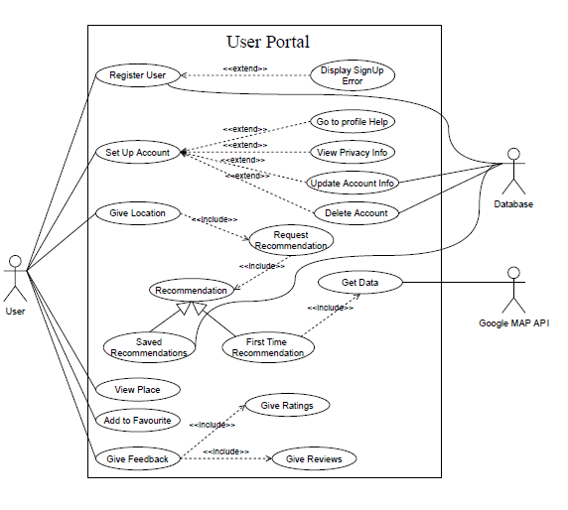
Use Cases

Slide 12
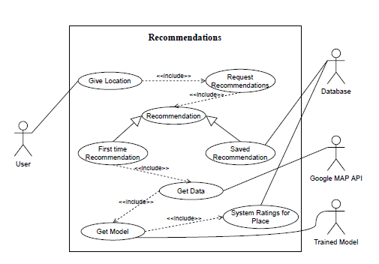
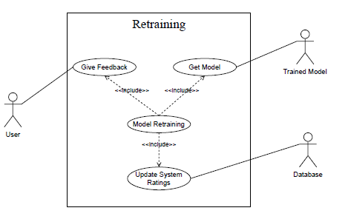
Use Cases

Slide 13
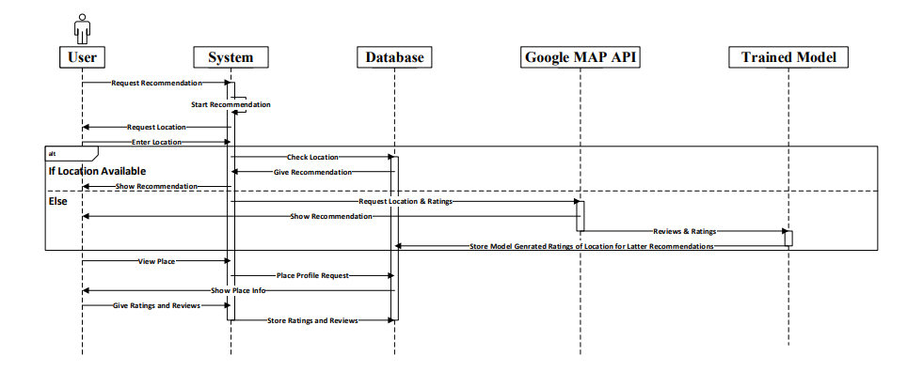
Sequence Diagram

Slide 14
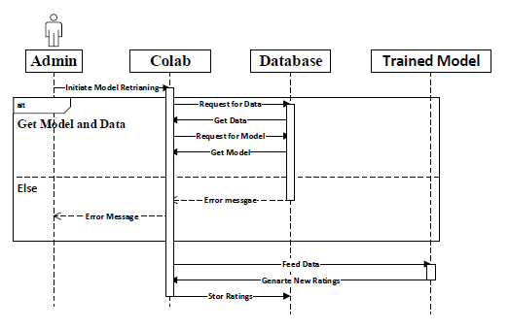
Sequence Diagram

Slide 15

Do you have
any questions?
Ask to us! We hope you learned something new.

